Slide 1

Hotel Booking ADR prediction
Naya College
Feb 2022
Partners:
Alon Ben Bassat
Liad Alkobi
Ohad Gamliel
Noam Levi Avshalom

Slide 2
Content
Goals
Dataset info
Cleaning data and removing outliers
Feature engineering
Linear regression before and after improvement
Decision tree regression
KNN regression
Conclusions

Slide 3
Goal and ADR definition
This project is designed to predict ADR for maximizing profits. In order to achieve this goal, we are going to use different kinds of regression models.
Calculated by dividing the sum of all lodging transactions by the total number of staying nights
ADR = Average Daily Rate
Possible uses:
Maximizing profits for these two hotels.
Competitive company to Booking – using this prediction to maximize ADR
Competitive hotel in this area

Slide 4
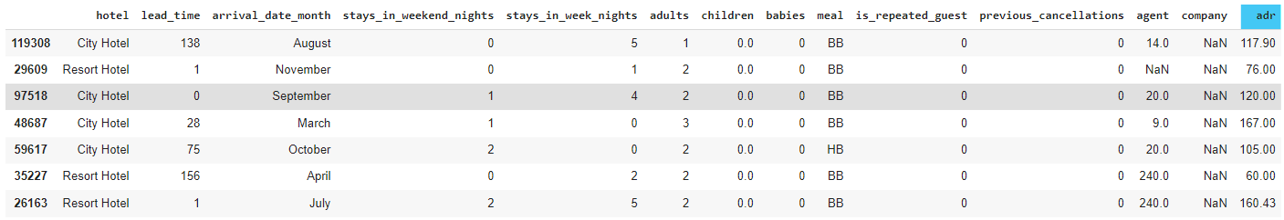
Dataset info
In this project we are going to use Kaggle’s dataset: “hotel booking demand”.
The dataset contains 119,390 rows and 32 columns, each row represents a transaction at a hotel.
Following are few of the most important columns for our analysis:
You can describe the topic of the section here
You can describe the topic of the section here

Slide 5
Cleaning data and removing outliers
Have been removed:
ADR < 25 and ADR > 5000.
Rooms with total guests = 0
Rooms with babies guests only.
Rooms with more than 5 guests in total.
Grouping:
Meals: “SC”, “unidentified”
SC_unidentified

Slide 6
Feature engineering
Calculated columns:
“is_resort” – a binary column, represents if the transaction was booked in a resort\city hotel.
“is_company” – a binary column, represents if the transaction was booked by a company\private customer.
“booked_by_agent_travel” – a binary column, represents if the transaction was through agent travel.
“month_num” – converting name of month to numbers.
“is_holiday” and “is_weekend - a binary column, represents if the arrival day is a holiday, and if the vacation is during the weekend.
“total_nights” and “total_guests” – for retrieving columns of number of nights and number of guests in total.
“is_family_w_babies” – a binary column, represents if the transaction was for a family or for guests with no babies.

Slide 7
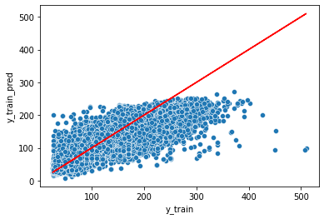

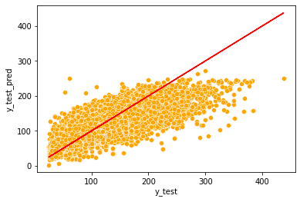
Linear regression
We repeatedly tried a variety of tests with our features and our calculated columns, and these are the best results we could achieve:
This model is valid but we are not happy with the results.
During the analysis, we found out that few important columns behave differently when the order is in a resort hotel versus when the order is in a city hotel.
Train – RMSE is 30.67
We decided to dig deeper, as we can see on the next slide
Test – RMSE is 30.34

Slide 8
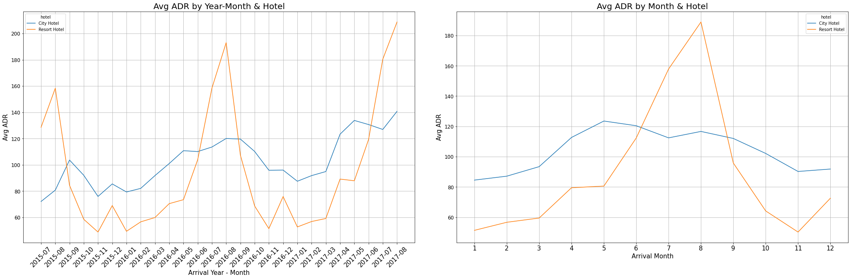
As we said, during our analysis we noticed that few important columns behave differently depending on the kind of hotel. For example: one of the most effective features is the season of booking.
Splitting the model - explanation

Slide 9
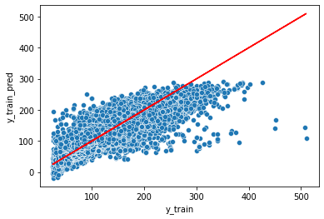
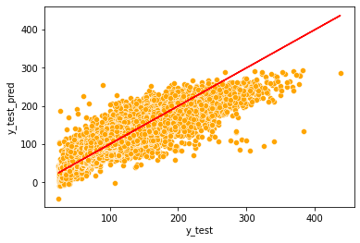
Linear regression - After improvement:
We created a complexed model that is split into two different models: one for each kind of hotels.
Indeed, we got huge improvement and our RMSE got much better:
Reminder: before using this model, we got
Test_RMSE = 30.34
Our new model is still valid and we definitively can say that this model’s prediction is much better.
Train – RMSE is 24.74
Test – RMSE is 24.35

Slide 10
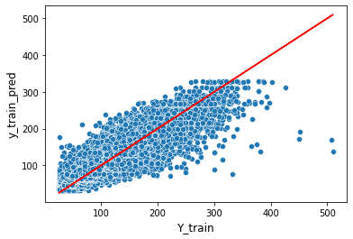
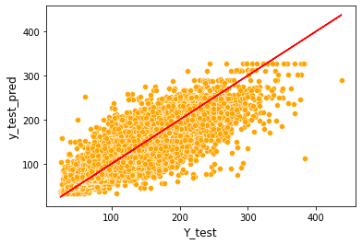
Decision tree regression
These are the hyper-parameters we eventually used:
This time, in advance we used our complexed model to get the best results (For safety we checked again without the complexed model – and indeed we got better results with the complexed model.)
Following are the results:
min_samples_leaf=10
ccp_alpha=0.01
max_leaf_nodes=1000
max_depth=100
As we can see, our model using decision tree regression is less valid than using linear regression, but the RMSE is much better.
To us, using decision tree regression is preferred, but it’s negotiable.
Train – RMSE is 18.17
Test – RMSE is 20.96

Slide 11
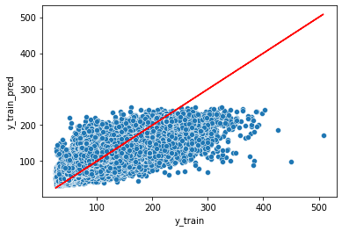
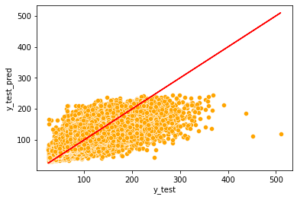
KNN regression
The only hyper-parameter we used is:
Like we did with decision tree regression, in advance, we used our complexed model to get the best results. (For safety, we checked anyway – and indeed we got better results with our complex model)
Following are the results:
n_neighbors = 17
As we can see, with KNN model we didn’t achieve better results ☹
Train – RMSE is 28.26
Test – RMSE is 29.86
You can describe the topic of the section here
You can describe the topic of the section here

Slide 12

Conclusions
Test_RMSE | Train_RMSE | Model
24.35 | 24.74 | Linear regression
20.96 | 18.17 | Decision tree regression
29.86 | 28.26 | KNN regression
With this data, we succeeded to achieve the best results with decision tree regression.
TBC:
Apply a user-defined metric with KNN model
Using scaling transformers
Analysis of the outliers based on our models.

